Slide 1
A marketing analytics project on Patanjali Ayurved
Submitted By
Section A
Group 1
Abhijeet Ramnath Selhi – 190101005
Abhinav Gupta – 190103005
Apoorva Vilas Kokate – 190103032
Ashik Ahmed – 190101032
Kunal Kumar Sahu – 190103075
Narsimha Nitesh Thota – 190110069

Slide 2
Industry overview - fmcg
Biscuits fall under the Food products category and is one of the fastest growing categories even though per capita consumption is less than developed countries
FMCG is the fourth largest sector in India
FMCG
Home and Personal Care
Food & Beverages (19%)
Healthcare
Tobacco
Beverages
Food Products
Dairy & Dairy Products
Bakery Products
Milling Products
References:
https://ezproxy.imt.edu:2062/statistics/750638/biscuits-and-snack-bars-sales-value-india/

Slide 3
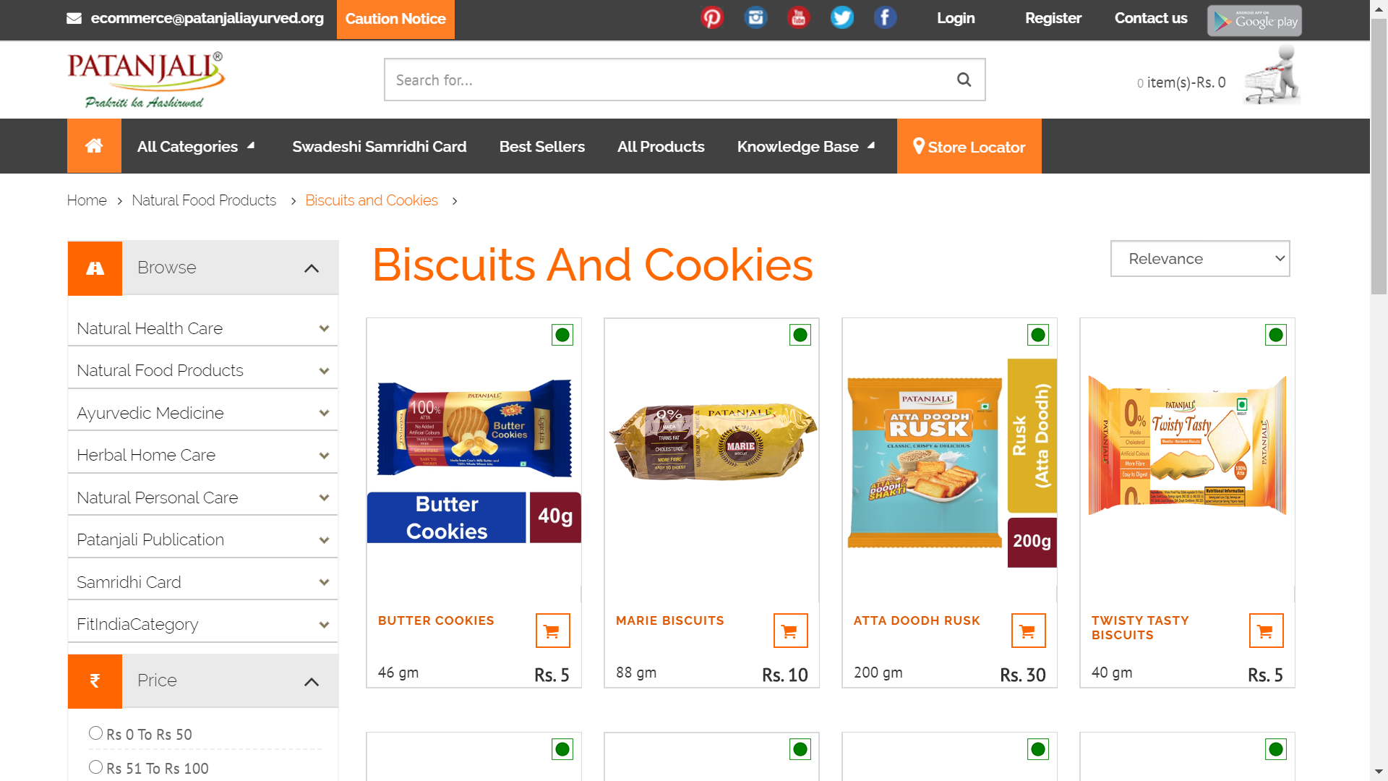
Patanjali biscuits overview
Patanjali Ayurved is a leading FMCG company in India founded in 2006
Patanjali entered the Indian FMCG market using flanking strategy
5-6% margin range in Patanjali products, whereas HUL provides around 50%
The biscuits fall under the Food products category
Market share of biscuits is 13.6% in dunk biscuits segment
Patanjali
Natural Health Care
Food Products
Ayurvedic Medicines
Herbal Home Care
Natural Personal Care
References:
https://ezproxy.imt.edu:2062/statistics/762057/india-biscuits-and-cookies-production-volume/
https://www.google.com/search?q=market+share+of+patanjali+biscuits&oq=market+share+of+patanjali+biscuits&aqs=chrome..69i57.8543j0j7&sourceid=chrome&ie=UTF-8

Slide 4
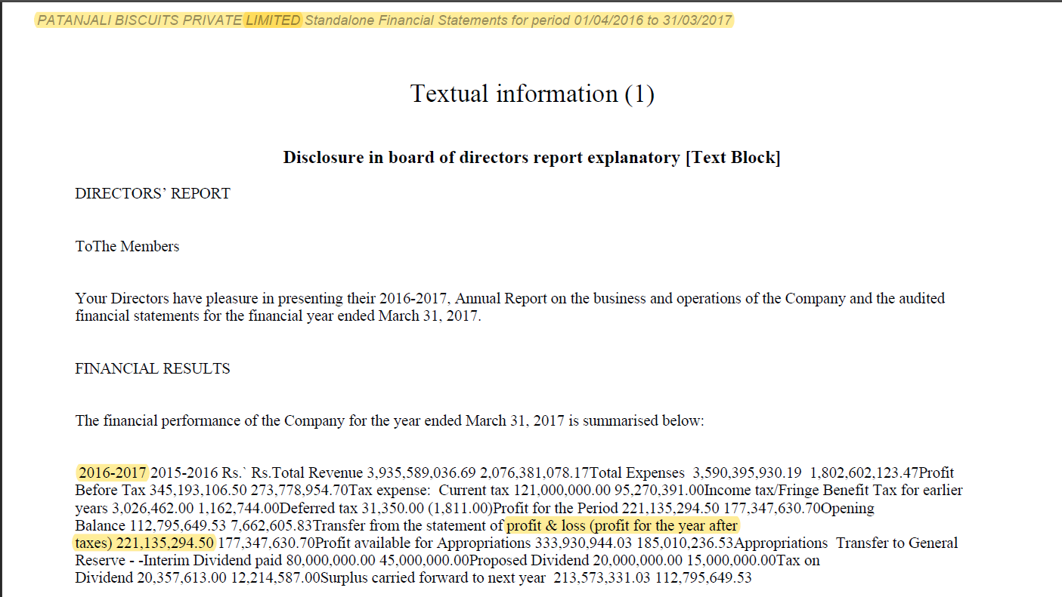
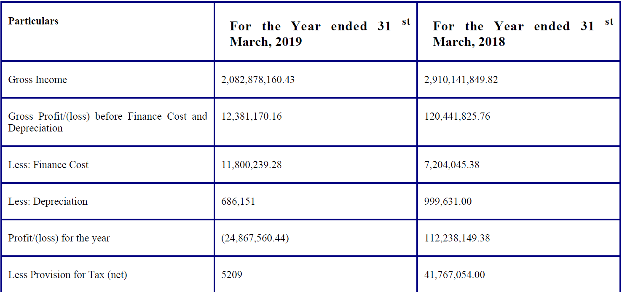
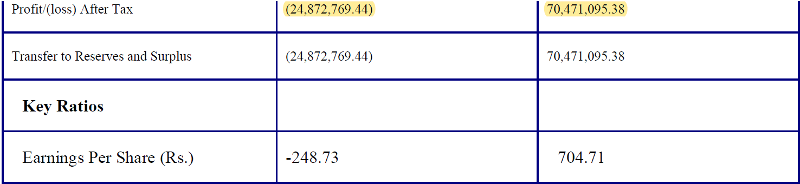
Rationale for selecting Patanjali biscuits brand
In the initial few years after its establishment Patanjali saw phenomenal growth vis-à-vis competitors
But in the past 3-4 years its performance in terms of Profit After Tax has been declining
Competitors benchmarked Patanjali’s offerings, which eroded their market share
Financial Performance Summary of Patanjali Biscuits for the F.Y. 2016-17
Downfall Trend in PAT for Patanjali Biscuits from 2016 to 2019
Patanjali financials for the year 2018 and 2019
Reference – Patanjali Annual Report

Slide 5
Hypotheses for testing
Below are the some of the hypotheses that were tested in our research
H1: Importance of Price while purchasing biscuits is different for different gender groups
H1: Importance of Quality while purchasing biscuits is different for different age groups
H1: Importance of Calories while purchasing biscuits is different for different gender groups
H1: Importance of Total Fat Content while purchasing biscuits is different for different age groups
H1: Perception of Patanjali Biscuits’ Price as lesser or higher vis-à-vis its competitors is different for different gender groups
H1: Perception of Patanjali Biscuits’ Quality as lesser or higher vis-à-vis its competitors is different for different age groups
H1: Perception of Patanjali Biscuits’ Total Fat Content as lesser or higher vis-à-vis its competitors is different for different age groups
H1: Perception of Patanjali Biscuits’ Sugar Content as lesser or higher vis-à-vis its competitors is different for different age groups
H1: First Time Trial of Patanjali biscuit is correlated to the consumer’s income group
H1: Continuation of Regular Consumption is Patanjali biscuits is correlated to consumer’s age group
H1: Patanjali Biscuits’ Brand Reliability is dependent on factors like – Perceived Price, Perceived Quality, Perceived Calories, Perceived Cholesterol Content, Perceived Total Fat Content, Perceived Carbohydrates Content, Perceived Sugar Content, Perceived Protein Content – all vis-à-vis competitors

Slide 6
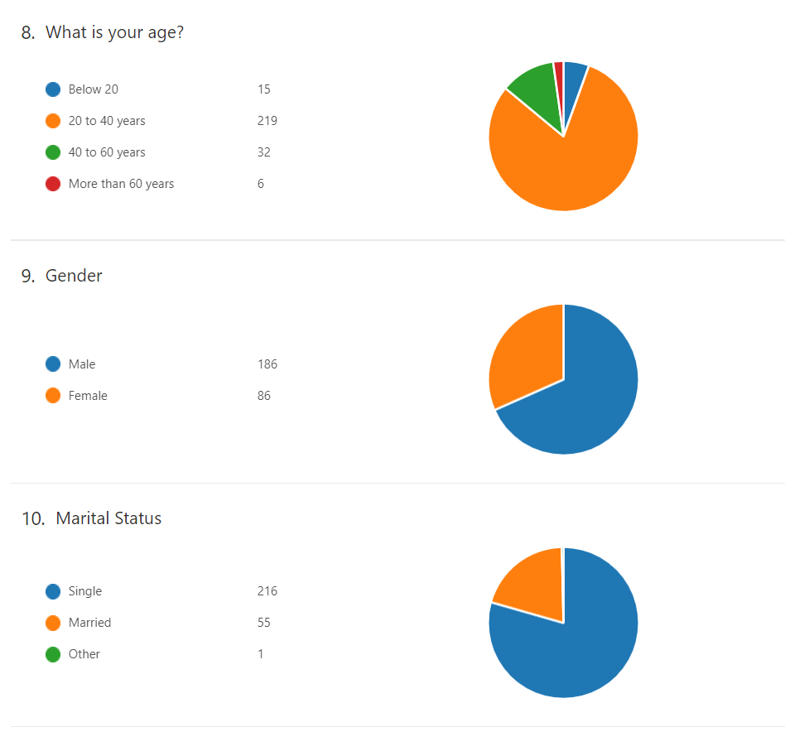
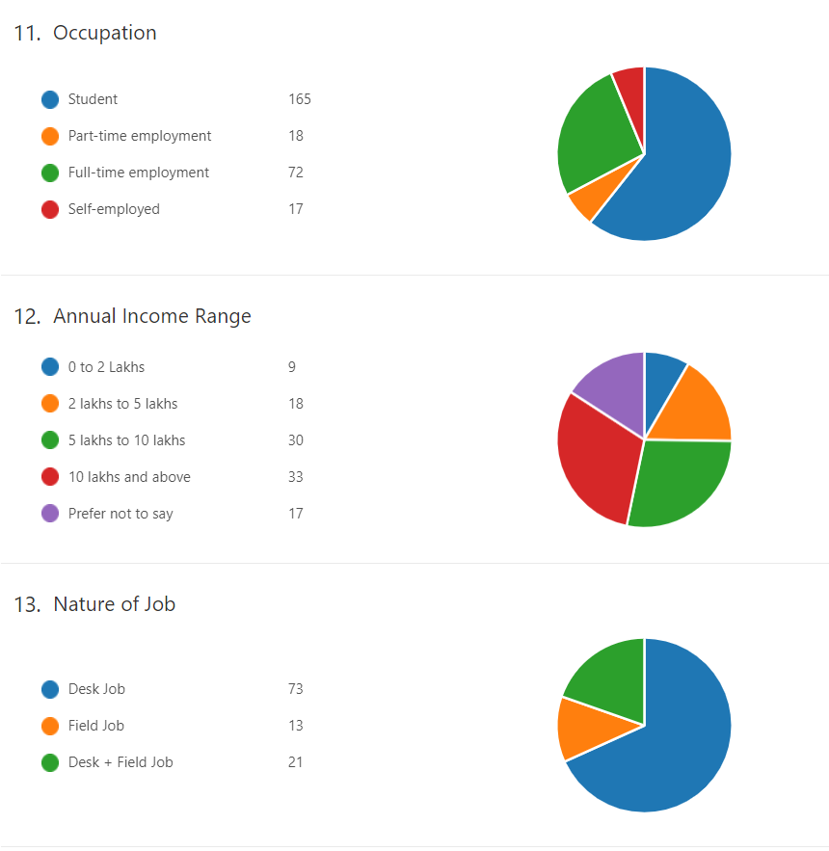
Methodology
An online survey was conducted and below are the demographics of the sample

Slide 7
Statistical techniques used 1/2
Data Cleaning: The below tests are used to check if the data follows normal distribution, as it is one of the main assumptions to conduct multivariate analysis. In the process the data is cleaned to ensure each item follows normal distribution
Skewness Kurtosis Analysis: Testing normality of the data based on the symmetry of the graph and concentration of data on the tails compared to a normal distribution
Box Test: The primary purpose of this test is to check the outliers and remove them, to maintain the normality of the distribution
Shapiro Wilk test: Testing the normality of distribution using hypothesis testing. Null Hypothesis: “The distribution is not normal ”
Interdependence: The below technique is used to check the correlation among different attributes
Bivariate Correlation Analysis: The correlation between all the independent variables should be checked to see if there will be a problem of multicollinearity

Slide 8
Statistical techniques used 2/2
Hypotheses Testing, Analyses and Interpretations:
1. Hypotheses Testing using Chi-squared tests: Test to check the correlation between categorical variables
2. Hypotheses Testing using One-way ANOVA tests: To check whether the mean for at least one group is significantly from that of other groups
3. Simple Linear Regression Analysis : To check and establish the causality among variables
4. Factor Analysis: To check the probability of existence of factors and the latent concept explained by underlying concepts- Overall Nutrition and Brand Image
5. Cluster Analysis using k-means: With the large sample size, the chance of having clusters is checked with a predefined maximum possible number of clusters

Slide 9
Skewness-kurtosis Analysis
Except for Quality, all other items have skewness and kurtosis within acceptable limits of [-1,1] and [-2,2] respectively. Hence, all are normally distributed.
For Quality, the limit is exceeded marginally owing to its inherent nature since people tend to give higher importance to quality everywhere.

Slide 10
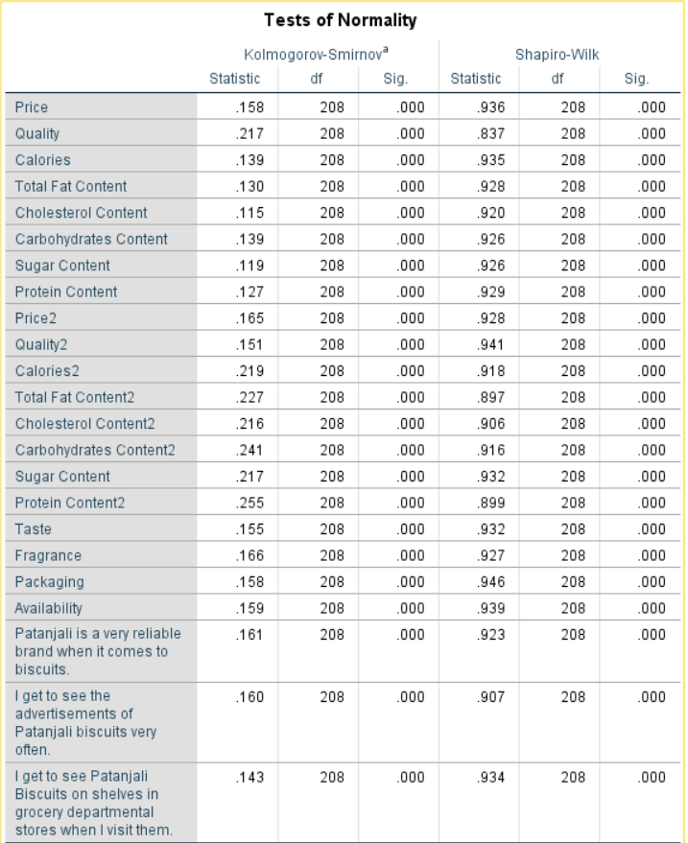
SHAPIRO-WILK TEST
Since all the significance values are less than 0.05, we reject the null hypotheses that the distribution are not normal. Hence, all the items are normally distributed.

Slide 11
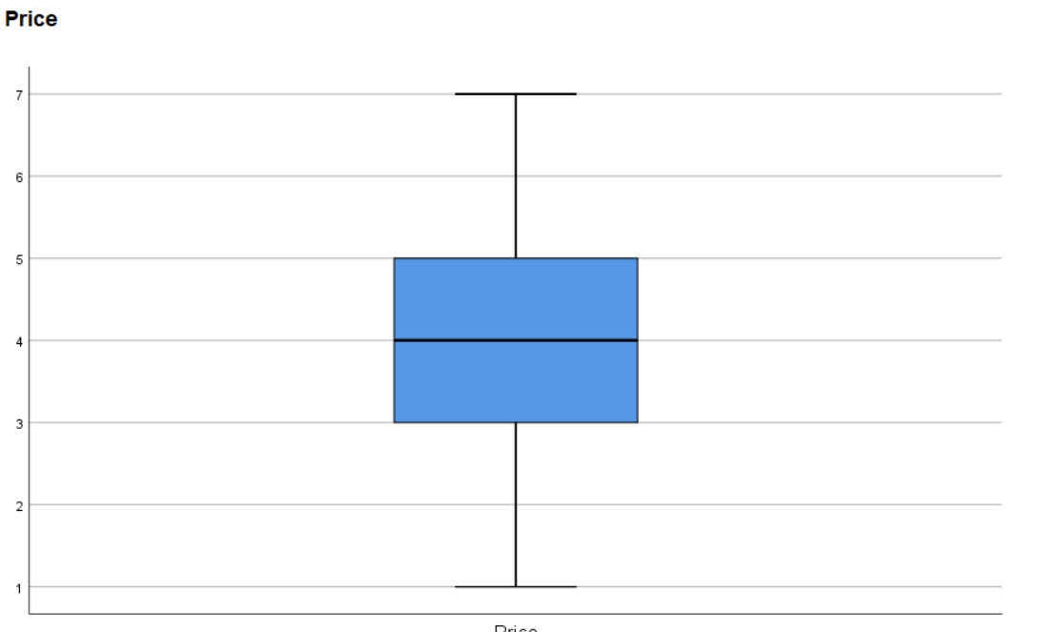
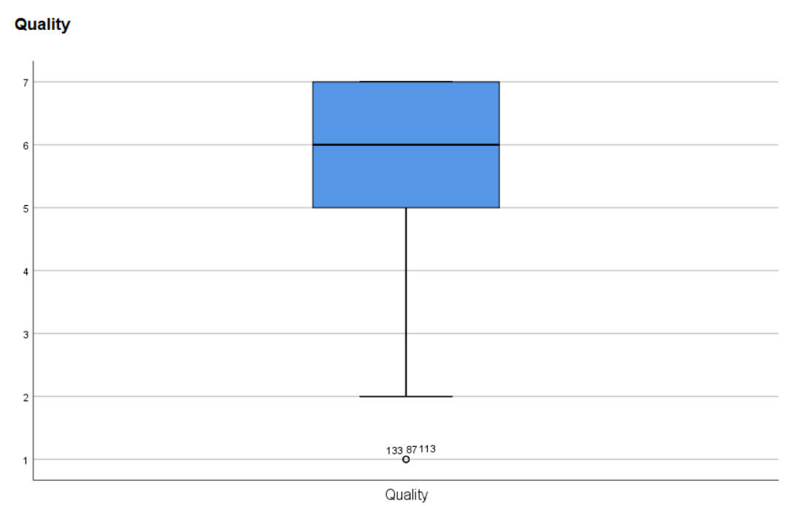
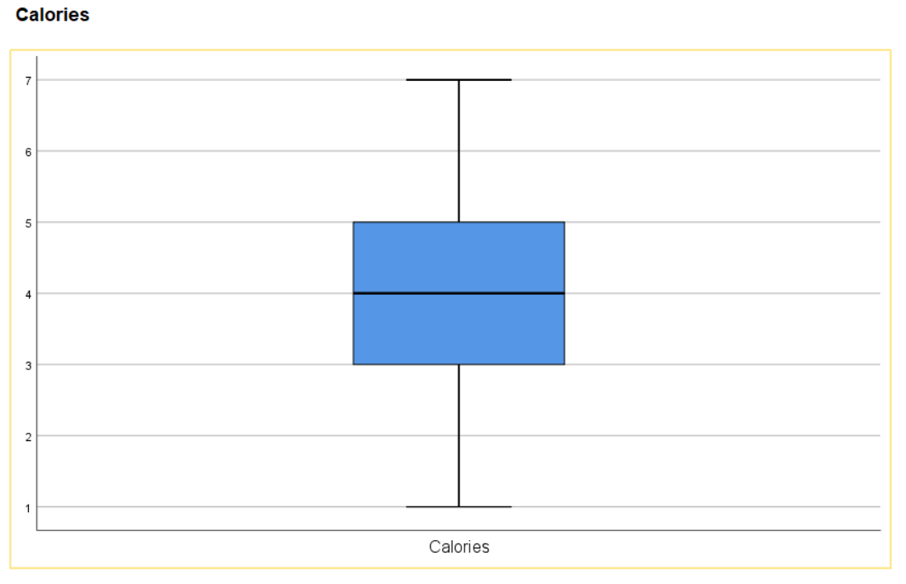
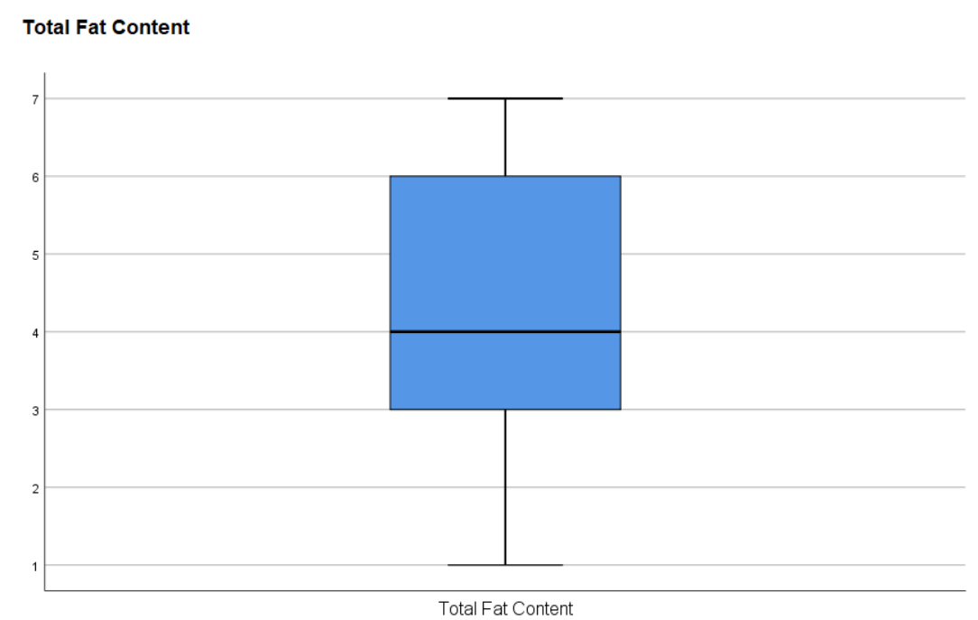
BOX plots

Slide 12
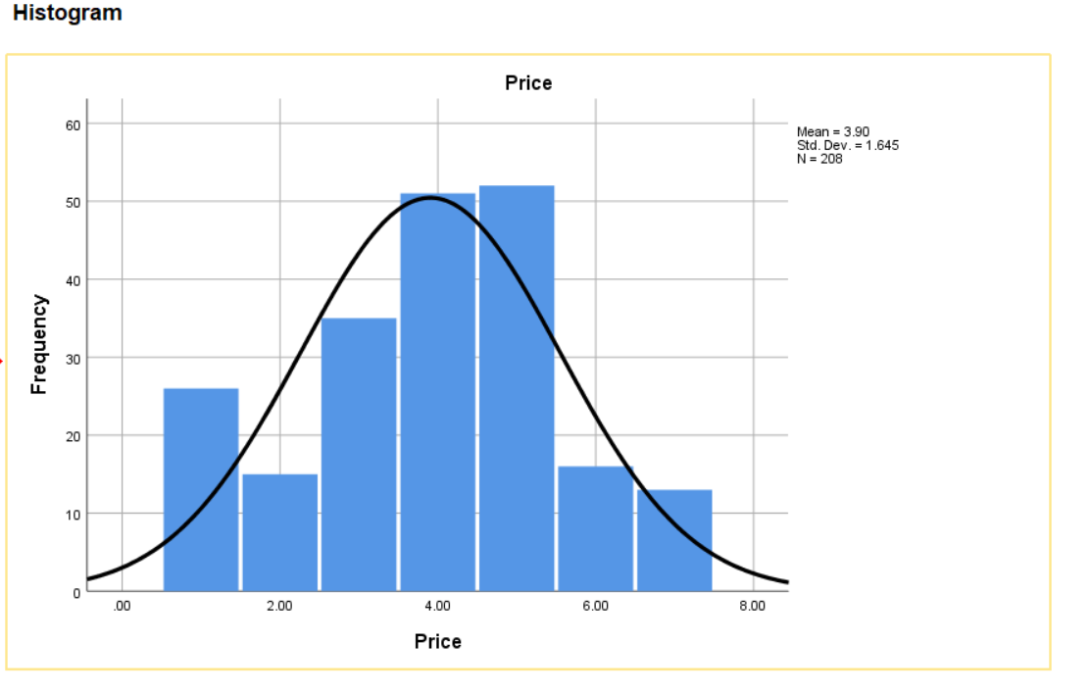
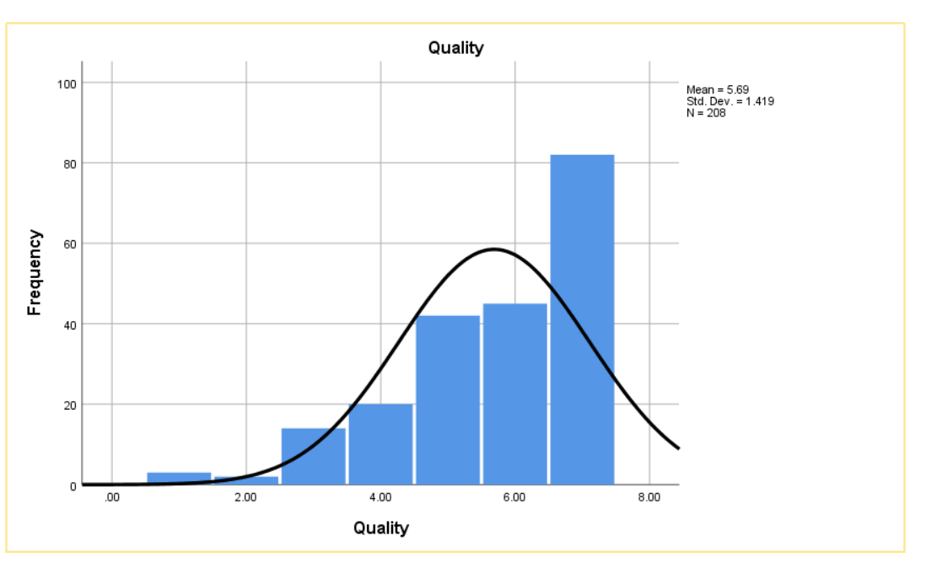
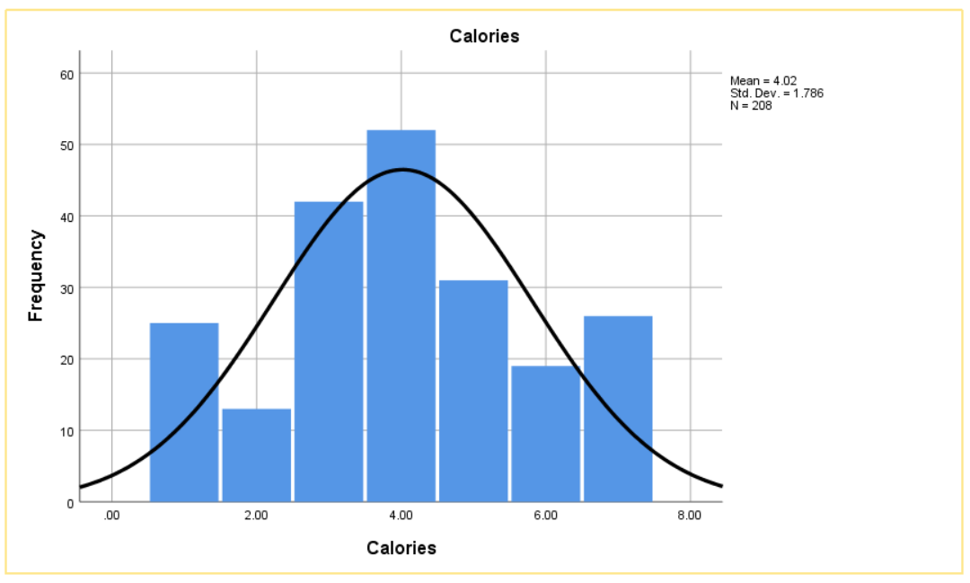
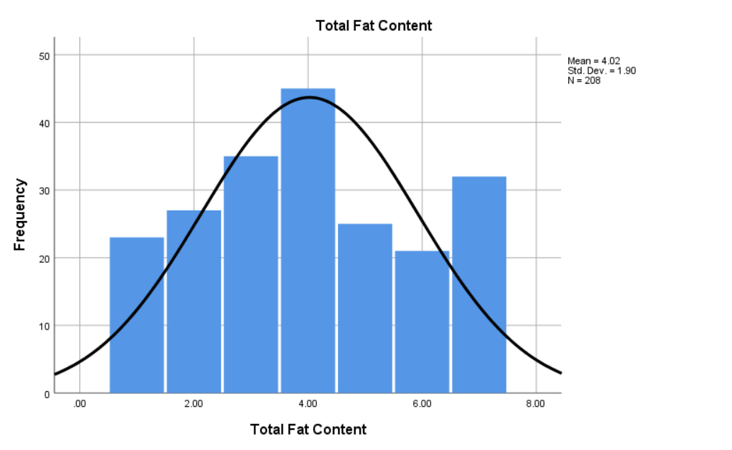
FREQUENCY Histograms

Slide 13
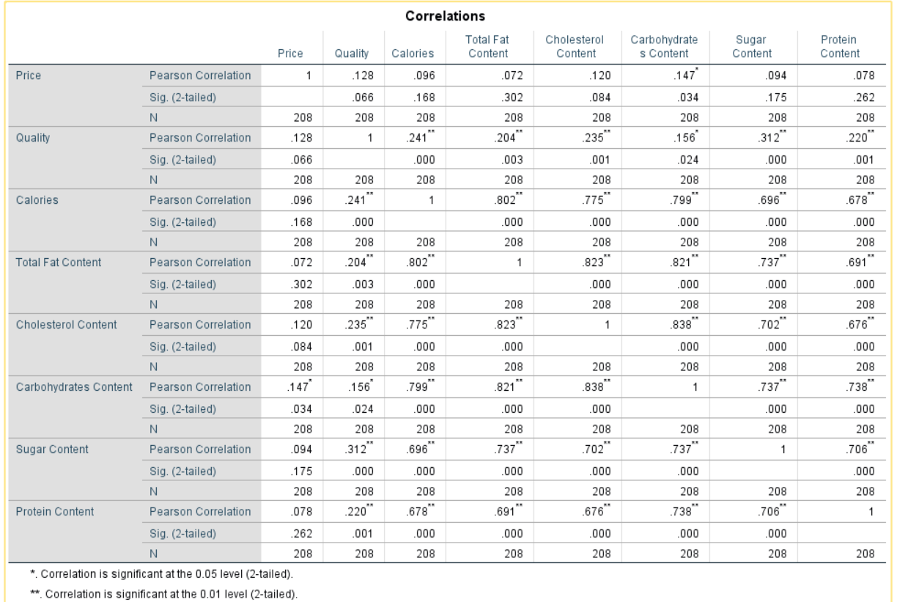
Bivariate correlation analysis

Slide 14
One-way anova and Independent sample t-test
Null Hypothesis | Output | Interpretation
The importance of Quality while purchasing biscuits is similar for different age groups | Both Levine’s test is Insignificant, ANOVA is Significant. Reject null hypothesis | The importance of Quality while purchasing a Pack of Biscuits is different across different Age Groups.
Importance of Total Fat Content while purchasing biscuits is similar for different gender groups. | Levine’s test is insignificant, and ANOVA is significant. Hence, Reject the null hypothesis | Importance of Total Sugar Content while purchasing a Pack of Biscuits across different Gender Groups is statistically different
Perception of Patanjali Biscuits’ Carbohydrates Content as lesser or higher vis-à-vis its competitors is similar for different gender groups. | Both Levine’s test and ANOVA are insignificant. Reject the null hypothesis | ‘Perception of Patanjali Biscuit’s Carbohydrate Content being Higher vis-à-vis Competition’ across different Gender Groups is statistically Different.
Importance of Price while purchasing biscuits is similar for different gender groups. | Both Levine’s test and ANOVA are insignificant. We fail to reject the null hypothesis | Importance of Price while purchasing a Pack of Biscuits across different Gender Groups is not statistically different
‘Perception of Patanjali Biscuits having Attractive Packaging’ is similar across different Gender Groups. | Both Levine’s test and ANOVA are insignificant. We fail to reject the null hypothesis | Perception of Patanjali Biscuit’s Attractive Packaging’ is not statistically different across different Gender Groups
NOTE: Please refer the appendix to access the ANOVA and Independent T-Test analysis of the rest of the hypotheses

Slide 15
Chi - squared test
Null Hypothesis | Output | Interpretation
Continuation of Regular Consumption is Patanjali biscuits is not correlated to consumer’s age grp | There is a significant correlation. Hence, we reject the null hypotheses | Continuation of Regular Consumption is Patanjali biscuits is correlated to the consumer’s age group
Continuation of Regular Consumption is Patanjali biscuits is not correlated to consumer’s gender group. | There is no significant correlation. We fail to reject the null hypothesis | Continuation of Regular Consumption is Patanjali biscuits is not correlated to the consumer’s gender group.
Continuation of Regular Consumption is Patanjali biscuits is not correlated to consumer’s income group | There is no significant correlation. We fail to reject the null hypothesis | Continuation of Regular Consumption is Patanjali biscuits is not correlated to the consumer’s income group.
Continuation of Regular Consumption is Patanjali biscuits is not correlated to consumer’s marital status | There is a significant correlation. Hence, we reject the null hypotheses | Continuation of Regular Consumption is Patanjali biscuits is correlated to the consumer’s marital group
Continuation of Regular Consumption is Patanjali biscuits is not correlated to consumer’s occupation. | There is no significant correlation. We fail to reject the null hypothesis | Continuation of Regular Consumption is Patanjali biscuits is not correlated to the consumer’s occupation group
NOTE: Please refer the appendix to access the Chi-Squared Tests analysis of the rest of the hypotheses

Slide 16
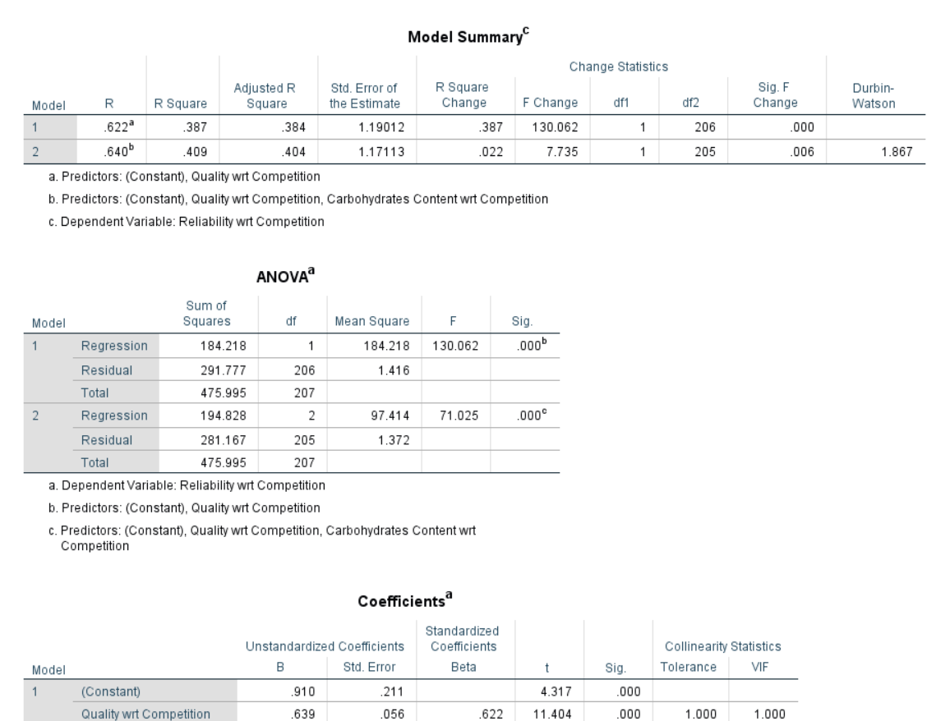
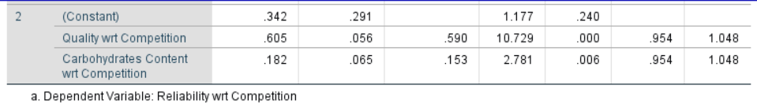
Regression test
H₀: Patanjali Biscuits’ Brand Reliability (DV) is not dependent on factors like – Perceived Price, Perceived Quality, Perceived Calories, Perceived Cholesterol Content, Perceived Total Fat Content, Perceived Carbohydrates Content, Perceived Sugar Content, Perceived Protein Content – all vis-à-vis competitors (all IVs)
Insights: SIMPLE Regression test
Insights: step-wise Regression test
Regression Model is significant (Regression p-value < 0.05)
VIF values are less than 10. Hence, no significant multicollinearity
Durbin Watson is between 1.5 to 2.5. Therefore, there is no autocorrelation.
The co-efficient of ‘Quality w.r.t Competition’ is significantly different from zero. Hence, this variable is significant in the regression.
All variables are normally distributed. This is evident from skewness-kurtosis values in the beginning and also the p-p plot here for the dependent variable.
Adjusted R-square is 0.4 which is good in our case

Slide 17
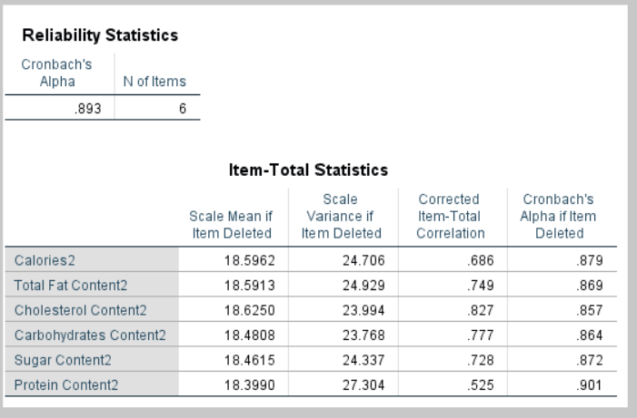
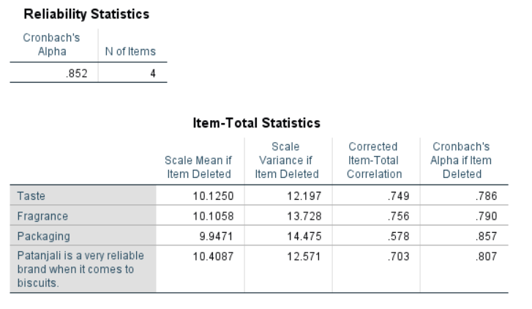
Cronbach alpha analysis
Items Reliability Check for Concept : Overall Nutrition
Items Reliability Check for Concept : Product Image
Cronbach Alpha values for both concepts > 0.8 indicating a good reliability of these items

Slide 18
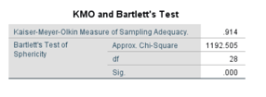
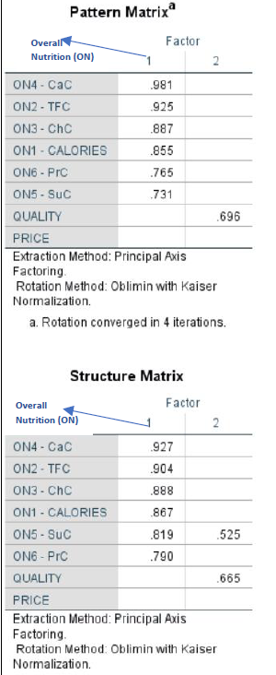
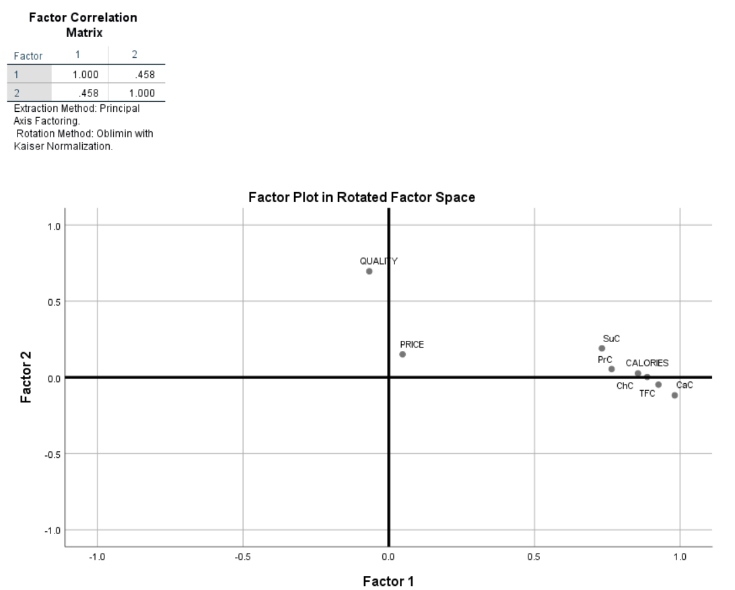
Factor analysis-principal AXIS FACTORING (1/2) (used due to large correlation between variables]
OVERALL Nutrition: Carbohydrates Content, Total Fat Content, Cholesterol Content, Calories, Sugar Content, Protein Content
KMO Adequacy = 0.914 > 0.5, Hence correlations between pairs of variables can be explained by other variables and factor analysis is appropriate.
Bartlett’s test of sphericity is also significant. Hence, factor analysis can be further performed.
Here the non-redundant residuals are lesser - just 2 (7%) i.e. only 2 residuals are larger than 0.05, indicating an acceptable model fit.
As per the Pattern Matrix, variances in Carbohydrates Content, Total Fat Content, Cholesterol Content, Calories, Sugar Content, Protein Content can be explained by Factor 1.
This is in line with pre-decided concept called ‘Overall Nutrition’ which is validated by Factor Analysis.
Further, Factor Plot in Rotated Space validates the same.

Slide 19
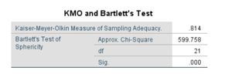
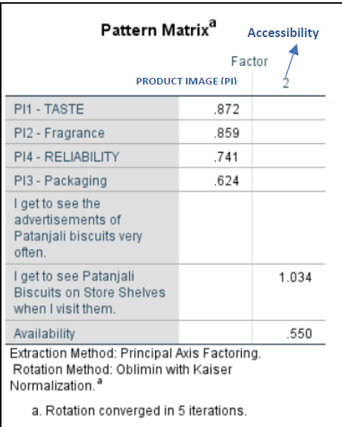
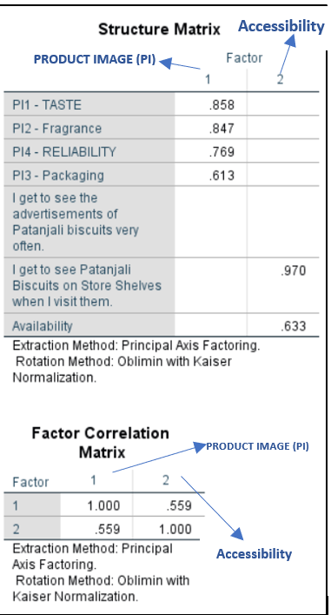
Factor analysis-principal AXIS FACTORING (2/2) (used due to large correlation between variables]
PRODUCT IMAGE: Taste, Fragrance, Packaging And Reliability
KMO Adequacy = 0.814 > 0.5, this indicate that the correlations between pairs of variables can be explained by other variables and that factor analysis is appropriate.
Bartlett’s test of sphericity is also significant. Hence, factor analysis can be further performed.
Here the non-redundant residuals are lesser - 3 (14%) i.e. 3 residuals are larger than 0.05, indicating an acceptable model fit.
As per the Pattern Matrix, variances in Reliability, Taste, Packaging and Fragrance can be explained by Factor 1.
This is in line with pre-decided concept called ‘Product Image’ which is validated by Factor Analysis.
Further, Factor Plot in Rotated Space validates the same.

Slide 20
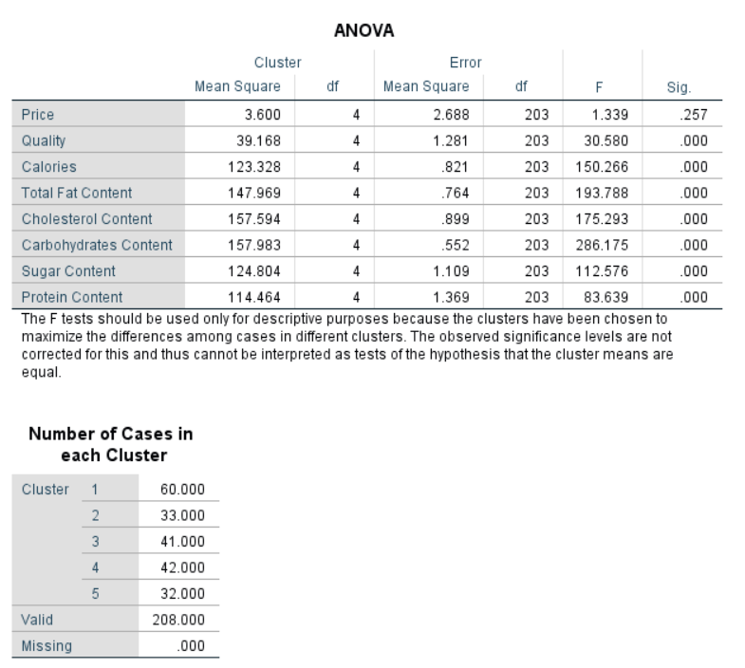
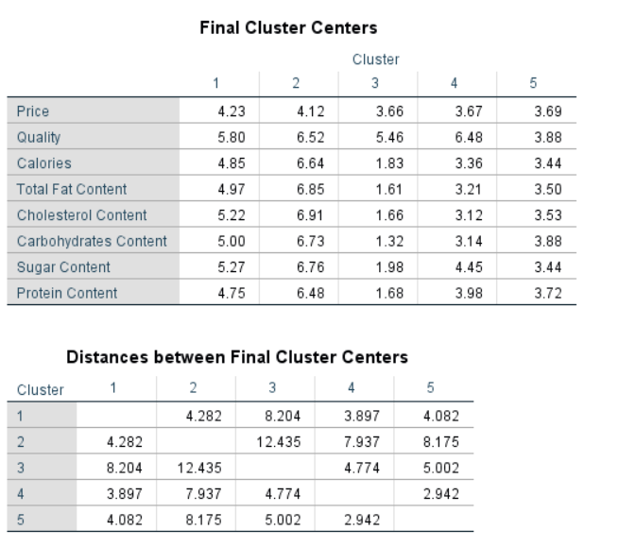
Cluster Analysis (1/2)
BEHAVIORAL VARIABLE
Importance Of Price While Purchasing A Pack Of Biscuits
Importance Of Quality While Purchasing A Pack Of Biscuits
Importance Of Calorie Content While Purchasing A Pack Of Biscuits
Importance Of Total Fat Content While Purchasing A Pack Of Biscuits
Importance Of Cholesterol Content While Purchasing A Pack Of Biscuits
Importance Of Carbohydrate Content While Purchasing A Pack Of Biscuits
Importance Of Sugar Content While Purchasing A Pack Of Biscuits
Importance Of Protein Content While Purchasing A Pack Of Biscuits
As can be seen from ANOVA Table, except Price, all the other behavioural variables are significantly different for each of the 5 clusters. These 5 cluster can be further mined using cluster-membership table to get additional insights of demographics and psychographics. Varying behavioural variables would make different sets of product offerings for each of the clusters.

Slide 21
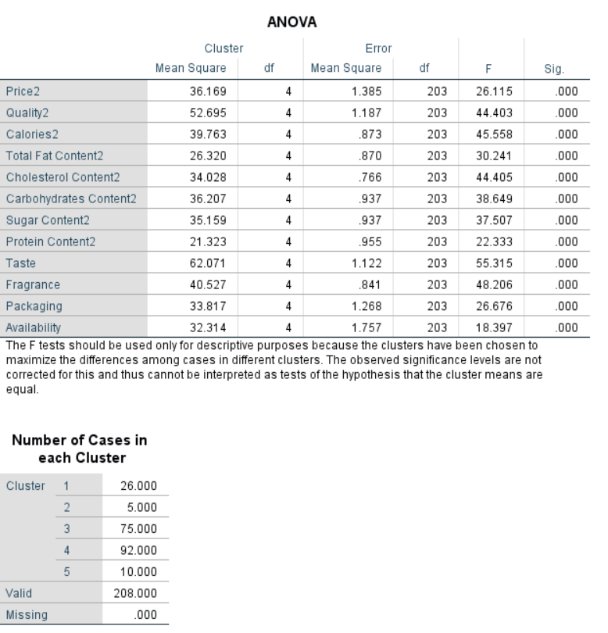
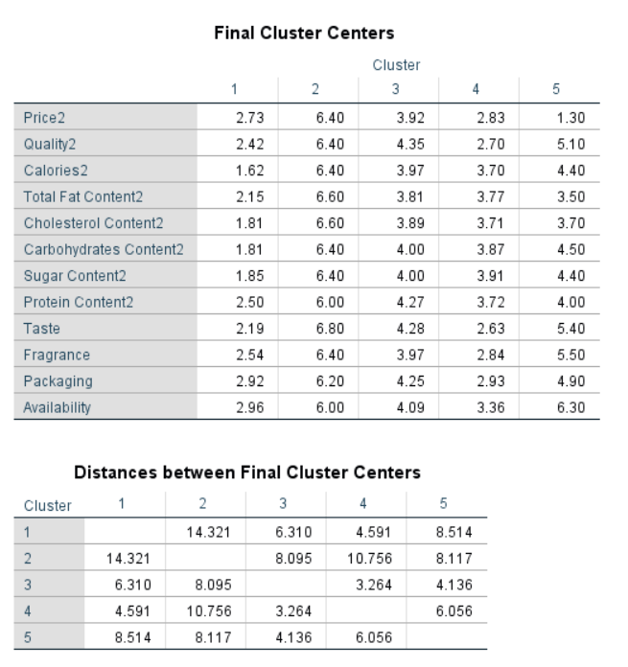
Cluster Analysis (2/2)
BEHAVIORAL VARIABLE
Perception of Patanjali Biscuits’ Price as lesser or higher vis-à-vis its competitors
Perception of Patanjali Biscuits’ Quality as lesser or higher vis-à-vis its competitors
Perception of Patanjali Biscuits’ Total Fat Content as lesser or higher vis-à-vis its competitors
Perception of Patanjali Biscuits’ Cholesterol Content as lesser or higher vis-à-vis its competitors
Perception of Patanjali Biscuits’ Carbohydrates Content as lesser or higher vis-à-vis its competitors
Perception of Patanjali Biscuits’ Sugar Content as lesser or higher vis-à-vis its competitors
Perception of Patanjali Biscuits’ Protein Content as lesser or higher vis-à-vis its competitors
Perception of Patanjali Biscuits’ Calories as lesser or higher vis-à-vis its competitors
Perception of Patanjali Biscuit’s Taste
Perception of Patanjali Biscuit’s Fragrance
Perception of Patanjali Biscuit’s Packaging
Perception of Patanjali Biscuit’s Availability
As can be seen from ANOVA Table, all the behavioural variables are significantly different for each of the 5 clusters. However, since there are only 4 cases in one of the clusters, we would not consider that particular cluster. Rest of the 4 clusters can be further mined using cluster-membership table to get additional insights of demographics and psychographics. Varying behavioural variables would make different sets of product offerings for each of the clusters.

Slide 22
Key recommendations
Since Latent Concepts - ‘Product Image’ and ‘Overall Nutrition’ have been successfully validated using Factor Analysis, individual items have to be carefully studied and used further for product development, brand equity building and marketing communications.
From K-means Cluster Analysis, 3 useful clusters are identified. These clusters can be further studied to develop buyer personas in terms of demographics and psychographics. These Buyer Personas can be used further for marketing campaign development.
From Regression, it is concluded that Brand Reliability is significantly dependent on the Quality of the product. Hence, Patanjali has to benchmark and beat the competitors on quality in order to improve its perceived value.
Based on shopping mission of different age groups, changes in the product packaging can be incorporated to enhance its visibility and product placement.
From Chi-Squared tests, it is concluded that there is a significant correlation between the ‘continuation of biscuit consumption’ and ‘age groups’. Hence, further research on individual age groups can be conducted which will highlight the ones that are not consuming anymore. Current consumers can be incentivized to promote the product in their respective circles and families.
Further, product sampling can be done for penetration in the non-current user age groups. In addition to this, advertising campaigns can be made where the identified current-user age group showcase the product benefits and encourage non-current user age groups to try the product.

Slide 23
APPENDIX

Slide 24
Data brief - spss coding and notations (1/2)

Slide 25
Data brief- spss coding and notations (2/2)

Slide 26
One-way anova and Independent sample t-test (1/6)
Null Hypothesis | Output | Interpretation
Importance of Total Fat Content while purchasing biscuits is similar for different age groups. | Both Levine’s test and ANOVA are insignificant. We fail to reject the null hypothesis | Importance of Total Fat Content while purchasing a Pack of Biscuits across different Age Groups is not statistically different
Importance of Sugar Content while purchasing biscuits is similar for different age groups. | Both Levine’s test and ANOVA are insignificant. We fail to reject the null hypothesis | The Importance of Total Sugar Content while purchasing a Pack of Biscuits across different Age Groups is not statistically different
Importance of Protein Content while purchasing biscuits is similar for different age groups | Both Levine’s test and ANOVA are insignificant. We fail to reject the null hypothesis | The Importance of Total Protein Content while purchasing a Pack of Biscuits across different Age Groups is not statistically different
Importance of Cholesterol Content while purchasing biscuits is similar for different age groups. | Both Levine’s test and ANOVA are insignificant. We fail to reject the null hypothesis | The Importance of Total Cholesterol Content while purchasing a Pack of Biscuits across different Age Groups is not statistically different
Importance of Carbohydrates Content while purchasing biscuits is similar for different age groups. | Both Levine’s test and ANOVA are insignificant. We fail to reject the null hypothesis | The Importance of Total Carbohydrate Content while purchasing a Pack of Biscuits across different Age Groups is not statistically different
The importance of Calories while purchasing biscuits is similar for different gender groups | Both Levine’s test and ANOVA are insignificant. We fail to reject the null hypothesis | The Importance of Total Calories Contents while purchasing a Pack of Biscuits across different Age Groups is not statistically different
Perception of Patanjali Biscuits’ Quality as lesser or higher vis-à-vis its competitors is similar for different age groups. | Both Levine’s test and ANOVA are insignificant. We fail to reject the null hypothesis | ‘Perception of Patanjali Biscuit’s Quality being lesser vis-à-vis Competition’ across different Age Groups is not statistically different.

Slide 27
One-way anova and Independent sample t-test (2/6)
Null Hypothesis | Output | Interpretation
Perception of Patanjali Biscuits’ Sugar Content as lesser or higher vis-à-vis its competitors is similar for different age groups | Both Levine’s test and ANOVA are insignificant. We fail to reject the null hypothesis | So, ‘Perception of Patanjali Biscuit’s Sugar Content being Higher vis-à-vis Competition’ across different Age Groups is not statistically different
Perception of Patanjali Biscuits’ Total Fat Content as lesser or higher vis-à-vis its competitors is similar for different age groups. | Both Levine’s test and ANOVA are insignificant. We fail to reject the null hypothesis | ‘Perception of Patanjali Biscuit’s Fat Content being Higher vis-à-vis Competition’ across different Age Groups is not statistically different
Perception of Patanjali Biscuits’ Protein Content as lesser or higher vis-à-vis its competitors is similar for different age groups | Both Levine’s test and ANOVA are insignificant. We fail to reject the null hypothesis | ‘Perception of Patanjali Biscuit’s Protein Content being Higher vis-à-vis Competition’ across different Age Groups is not statistically different
Perception of Patanjali Biscuits’ Cholesterol Content as lesser or higher vis-à-vis its competitors is similar for different age groups | Both Levine’s test is significant. But the Brown-Forsythe Test is insignificant. We fail to reject the null hypothesis | ‘Perception of Patanjali Biscuit’s Cholesterol Content being Higher vis-à-vis Competition’ across different Age Groups is not statistically different.
Perception of Patanjali Biscuits’ Carbohydrates Content as lesser or higher vis-à-vis its competitors is similar for different age groups | Both Levine’s test and ANOVA are insignificant. We fail to reject the null hypothesis | ‘Perception of Patanjali Biscuit’s Carbohydrate Content being Higher vis-à-vis Competition’ across different Age Groups is not statistically different
Perception of Patanjali Biscuits’ Calories Content as lesser or higher vis-à-vis its competitors is similar for different age groups. | Both Levine’s test and ANOVA are insignificant. We fail to reject the null hypothesis | ‘Perception of Patanjali Biscuit’s Calorie Content being Higher vis-à-vis Competition’ across different Age Groups is not statistically different.
‘Perception of Patanjali Biscuit’s High Availability in Stores’ is similar across different Age Groups. | Both Levine’s test and ANOVA are insignificant. We fail to reject the null hypothesis | ‘Perception of Patanjali Biscuit’s High Availability in Stores’ across different Age Groups is not statistically different

Slide 28
One-way anova and Independent sample t-test (3/6)
Null Hypothesis | Output | Interpretation
‘Perception of Patanjali Biscuit’s Good Fragrance’ is similar across different Age Groups. | Both Levine’s test and ANOVA are insignificant. We fail to reject the null hypothesis | ‘Perception of Patanjali Biscuit’s Good Fragrance’ across different Age Groups is not statistically different.
‘Perception of Patanjali Biscuits having Attractive Packaging’ is similar across different Age Groups | Both Levine’s test and ANOVA are insignificant. We fail to reject the null hypothesis | ‘Perception of Patanjali Biscuit’s Attractive Packaging’ is different across different Age Groups.
‘Perception of Patanjali Biscuit’s Superior Taste’ is similar across different Age Groups | Both Levine’s test and ANOVA are insignificant. We fail to reject the null hypothesis | ‘Perception of Patanjali Biscuit’s Superior Taste’ across different Age Groups is not statistically different.
Visibility of Patanjali Biscuits Through Advertisement is similar across different Age Groups. | Both Levine’s test and ANOVA are insignificant. We fail to reject the null hypothesis | the Visibility of Patanjali Biscuits Through Advertisement across different Age Groups is not statistically different
Reliability of Patanjali Biscuits is similar across different Age Groups | Both Levine’s test and ANOVA are insignificant. We fail to reject the null hypothesis | Reliability of Patanjali Biscuits across different Age Groups is not statistically different.
Visibility of Patanjali Biscuits in Store Shelves is similar across different Age Groups. | Both Levine’s test and ANOVA are insignificant. We fail to reject the null hypothesis | Visibility of Patanjali Biscuits in Store Shelves across different Age Groups is not statistically different.
Importance of Quality while purchasing biscuits is similar for different gender groups | Both Levine’s test and ANOVA are insignificant. We fail to reject the null hypothesis | the Importance of Quality while purchasing a Pack of Biscuits across different Gender Groups is not statistically different

Slide 29
One-way anova and Independent sample t-test (4/6)
Null Hypothesis | Output | Interpretation
Importance of Protein Content while purchasing biscuits is similar for different gender groups. | Both Levine’s test and ANOVA are insignificant. We fail to reject the null hypothesis | The Importance of Total Protein Content while purchasing a Pack of Biscuits across different Gender Groups is not statistically different
Importance of Cholesterol Content while purchasing biscuits is similar for different gender groups. | Both Levine’s test and ANOVA are insignificant. We fail to reject the null hypothesis | The Importance of Total Cholesterol Content while purchasing a Pack of Biscuits across different Gender Groups is not statistically different.
Importance of Carbohydrates Content while purchasing biscuits is similar for different gender groups | Both Levine’s test and ANOVA are insignificant. We fail to reject the null hypothesis | Importance of Total Carbohydrate Content while purchasing a Pack of Biscuits across different Gender Groups is not statistically different
Importance of Calories while purchasing biscuits is similar for different gender groups. | Both Levine’s test and ANOVA are insignificant. We fail to reject the null hypothesis | Importance of Total Calorie Content while purchasing a Pack of Biscuits across different Gender Groups is not statistically different
Perception of Patanjali Biscuits’ Price as lesser or higher vis-à-vis its competitors is similar for different gender groups | Both Levine’s test and ANOVA are insignificant. We fail to reject the null hypothesis | ‘Perception of Patanjali Biscuit’s Price being Higher vis-à-vis Competition’ across different Age Groups is not statistically different
Perception of Patanjali Biscuits’ Calorie Content as lesser or higher vis-à-vis its competitors is similar for different gender groups | Both Levine’s test and ANOVA are insignificant. We fail to reject the null hypothesis | ‘Perception of Patanjali Biscuit’s Calorie Content being Higher vis-à-vis Competition’ across different Age Groups is not statistically different

Slide 30
One-way anova and Independent sample t-test (5/6)
Null Hypothesis | Output | Interpretation
Perception of Patanjali Biscuits’ Cholesterol Content as lesser or higher vis-à-vis its competitors is similar for different gender groups. | Both Levine’s test and ANOVA are insignificant. We fail to reject the null hypothesis | ‘Perception of Patanjali Biscuit’s Cholesterol Content being Higher vis-à-vis Competition’ across different Age Groups is not statistically different.
Perception of Patanjali Biscuits’ Protein Content as lesser or higher vis-à-vis its competitors is similar for different gender groups | Both Levine’s test and ANOVA are insignificant. We fail to reject the null hypothesis | ‘Perception of Patanjali Biscuit’s Protein Content being Higher vis-à-vis Competition’ across different Age Groups is not statistically different.
‘Perception of Patanjali Biscuit’s High Availability in Stores’ is similar across different Gender Groups. | Both Levine’s test and ANOVA are insignificant. We fail to reject the null hypothesis | ‘Perception of Patanjali Biscuit’s High Availability in Stores’ across different Gender Groups is not statistically different
‘Perception of Patanjali Biscuit’s Good Fragrance’ is similar across different Gender Groups | Both Levine’s test and ANOVA are insignificant. We fail to reject the null hypothesis | ‘Perception of Patanjali Biscuit’s Good Fragrance’ across different Gender Groups is not statistically different
‘Perception of Patanjali Biscuit’s Superior Taste’ is similar across different Gender Groups | Both Levine’s test and ANOVA are insignificant. We fail to reject the null hypothesis | ‘Perception of Patanjali Biscuit’s Superior Taste’ across different Gender Groups is not statistically different.
Visibility of Patanjali Biscuits Through Advertisement is similar across different Gender Groups. | Both Levine’s test and ANOVA are insignificant. We fail to reject the null hypothesis | Visibility of Patanjali Biscuits Through Advertisement across different Gender Groups is not statistically different
Reliability of Patanjali Biscuits is similar across different Gender Groups. | Both Levine’s test and ANOVA are insignificant. We fail to reject the null hypothesis | Reliability of Patanjali Biscuits across different Gender Groups is not statistically different.
Visibility of Patanjali Biscuits in Store Shelves is similar across different Gender Groups | Both Levine’s test and ANOVA are insignificant. We fail to reject the null hypothesis | Visibility of Patanjali Biscuits in Store Shelves across different Gender Groups is not statistically different

Slide 31
One-way anova and Independent sample t-test (6/6)
Null Hypothesis | Output | Interpretation
Importance of Price while purchasing biscuits is similar for different marital groups. | Both Levine’s test and ANOVA are insignificant. We fail to reject the null hypothesis | Importance of Price while purchasing a Pack of Biscuits across different Marital Status Groups is not statistically different
Perception of Patanjali Biscuits’ Price as lesser or higher vis-à-vis its competitors is similar for different marital groups. | both Levine’s test is significant, and ANOVA is insignificant. Also, the Brown-Forsythe Test is insignificant. We fail to reject the null hypothesis | ‘Perception of Patanjali Biscuit’s Price being Higher vis-à-vis Competition’ across different Marital Status Groups is not statistically different.
Importance of Price while purchasing biscuits is similar for different income groups | Both Levine’s test and ANOVA are insignificant. We fail to reject the null hypothesis | Importance of Price while purchasing a Pack of Biscuits across different Income Groups is not statistically different
Perception of Patanjali Biscuits’ Price as lesser or higher vis-à-vis its competitors is similar for different income groups. | both Levine’s test is significant, and ANOVA is insignificant. Also, the Brown-Forsythe Test is insignificant. We fail to reject the null hypothesis | Perception of Patanjali Biscuit’s Price being Higher vis-à-vis Competition’ across different Income Groups is not statistically different.

Slide 32
Chi-square test
Null Hypothesis | Output | Interpretation
First Time Trial of Patanjali biscuit is not correlated to the consumer’s age group | There is no significant correlation. We fail to reject the null hypothesis | First Time Trial of Patanjali biscuit is not correlated to the consumer’s age group.
First Time Trial of Patanjali biscuit is not correlated to the consumer’s gender group | There is no significant correlation. We fail to reject the null hypothesis | First Time Trial of Patanjali biscuit is not correlated to the consumer’s gender group
First Time Trial of Patanjali biscuit is not correlated to the consumer’s income group | There is no significant correlation. We fail to reject the null hypothesis | First Time Trial of Patanjali biscuit is not correlated to the consumer’s income group
First Time Trial of Patanjali biscuit is not correlated to the consumer’s marital status | There is no significant correlation. We fail to reject the null hypothesis | First Time Trial of Patanjali biscuit is not correlated to the consumer’s marital status group
First Time Trial of Patanjali biscuit is not correlated to the consumer’s occupation | There is no significant correlation. We fail to reject the null hypothesis | First Time Trial of Patanjali biscuit is not correlated to the consumer’s occupation group
Continuation of Regular Consumption is Patanjali biscuits is not correlated to consumer’s occupation. | There is no significant correlation. We fail to reject the null hypothesis | Continuation of Regular Consumption is Patanjali biscuits is not correlated to the consumer’s occupation group

